Slide 1

JACKIE
Notes:
This is Jackie. Her menstrual cycle started this morning, and with it came some painful menstrual cramps. Thankfully, she is able to alleviate her cramps by taking 1 ibuprofen every 6 hours as needed for the first day of her cycle. Then she is all smiles and good to go!

Slide 2

MAYA
Notes:
This is Maya. Just like Jackie, Maya’s menstrual cycle began this morning and brought along some accompanying menstrual cramps. Unlike Jackie, 1 ibuprofen does nothing for Maya. Maya has to take 4 capsules every 6 hours to feel pain relief, and she experiences cramps up until the 4th day of her cycle–so she has to adhere to that strict medication regimen for 4 consecutive days.

Slide 3
24 hrs in a day / 6 hr Time intervals = 4 ibuprofen doses per day
4 doses per day * 4 pills per dose = 16 pills per day
16 pills per day * 4 days of menstrual cramps =
64 pills per month
64 pills per month * 12 months in a year =
768 pills per year
35 years of menstruation * 768 pills per year =
26,880 ibuprofen pills in Maya’s lifetime
Notes:
Women typically menstruate for 35-40 years so on the low end in Maya’s lifetime that is over 26k pills

Slide 4
Kidney disease is the 8th leading cause of death in the US, followed by liver disease.
*The CDC, 2023
PROBLEM
https://www.cdc.gov/nchs/fastats/leading-causes-of-death.htm
Notes:
While often attributed to other factors, a major, hidden contributor to chronic organ injury is the unmonitored, long-term, high-dosage use of NSAIDs to manage debilitating pelvic pain.

Slide 5
The Solution: CycleSIGHT
Because pain isn’t one-size-fits-all.
Notes:
To stop this cycle of damage, we created CycleSIGHT. We aren't just selling a test; we are offering a personalized treatment roadmap for $200. Our CLIA-certified laboratory developed test analyzes specific genetic markers related to drug metabolism, pain sensitivity, and endometriosis risk. This empowers clinicians to stop guessing and start treating. Why is this important? Because pain isn’t one-size-fits-all — but treatment often is. When underlying pain biology isn’t considered, patients may depend on repeated NSAID use, increasing their risk of kidney and liver disease. We provide a precision pain profile that helps prevent that avoidable harm.

Slide 6
Genetic Variants of Interest
Drug Metabolism
Pain Sensitivity
Endometriosis Risk
SNPs rs1799853 & rs1057910 in the CYP2C9 gene on chromosome 10
Associated Effect: Decreased/Nonexistent NSAID metabolism
SNP rs4680 in the COMT gene on chromosome 22→Increased pain perception
SNP rs20417 in the PTGS2 (COX-2) gene on chromosome 1→Decreased NSAID efficacy
SNP rs17562 in the ILA1 gene on chromosome 2
SNP rs7521902 in the WNT4 gene on chromosome 1
Associated Effect: Increased endometriosis susceptibility

Slide 7
The CycleSIGHT Journey
Patient Consultation
Test Ordered
Collect Sample
Molecular Analysis
Personalized Care
Patient presents at PCP or health clinic with symptoms such as:
-Severe dysmenorrhea
-Suspected endometriosis
-Issues with standard NSAID/hormonal therapy
Clinician orders CycleSIGHT test.
The kit is shipped to the patient’s home.
Patient provides a saliva sample via a painless buccal swab and mails it back to the lab.
The patient's saliva sample is analyzed at our CLIA-certified lab using qPCR TaqMan assay technology to identify targeted SNP genotypes for 6 key markers in the CYP2C9, COMT, PTGS2, IL1A, and WNT4 genes
A report is generated and sent to the clinician.
The clinician uses the report to guide treatment such as switching from NSAIDs to alternative analgesic methods, adjusting NSAID dosage, and/or expediting specialized imaging for endometriosis.

Slide 8
Genetic Profile (SNP) | Finding | Possible Clinical Interpretation from CycleSIGHT Report
CYP2C9 (rs1799853/rs1057910) | *2 or *3 Allele | "NSAID Metabolism Issue." Patient is a slow/poor metabolizer. High risk of toxicity with standard NSAID doses.
COMT (rs4680) | Met/Met Genotype | "High Pain Sensitivity." Patient requires stronger pain management interventions; low tolerance for discomfort.
PTGS2 (rs20417) | C/C Genotype | "Low NSAID Efficacy." Patient naturally produces fewer prostaglandins via COX-2. NSAIDs are unlikely to provide significant relief.
IL1A/WNT4 (rs17561/rs7521902) | Risk Variants Present | "High Endometriosis Risk." Strongly supports early diagnostic imaging (MRI/Ultrasound) to reduce diagnostic delay.

Slide 9



Meet the team
Farruh Turgunov
Gloria Jackson
CFO
CEO
Directs financial strategy, market analysis, and venture positioning to ensure long-term sustainability
Drives the development of personalized diagnostic tools by bridging clinical workflow insights with advanced genomic research
Aiyana Sharpe
CTO
Bridges genomic rigor with clinical workflow, leading technical development and assay design for a scalable, provider-friendly platform
Notes:
Why is our team special? We are passionate individuals combining clinical and bioinformatic expertise.

Slide 10
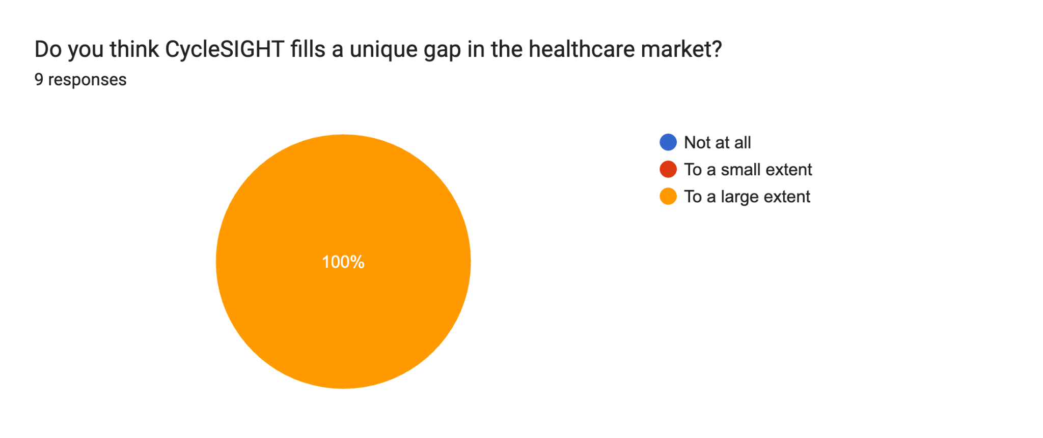
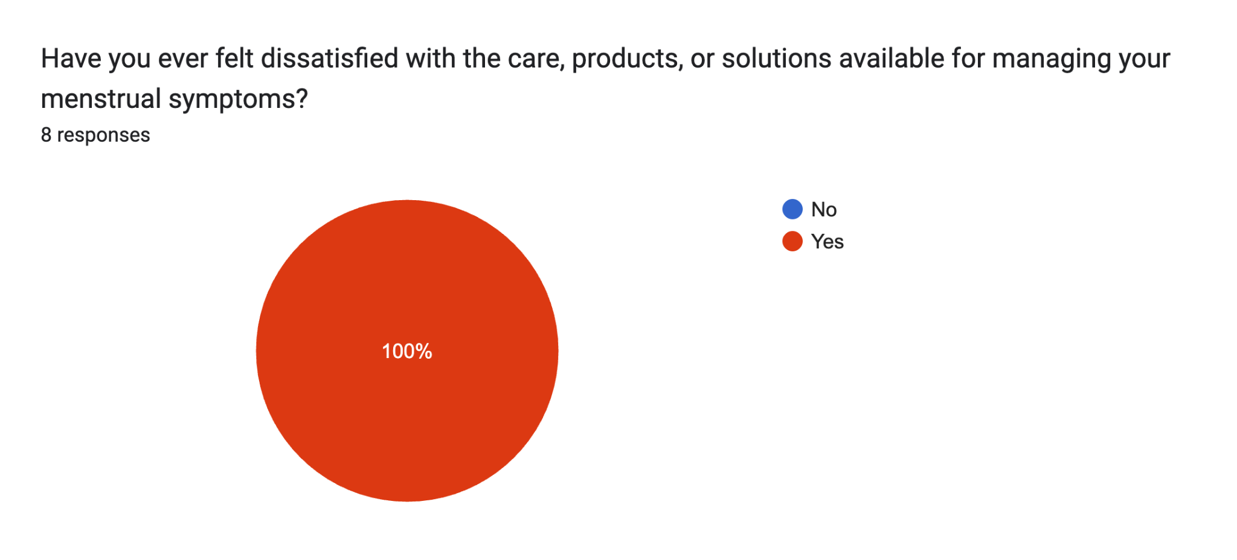
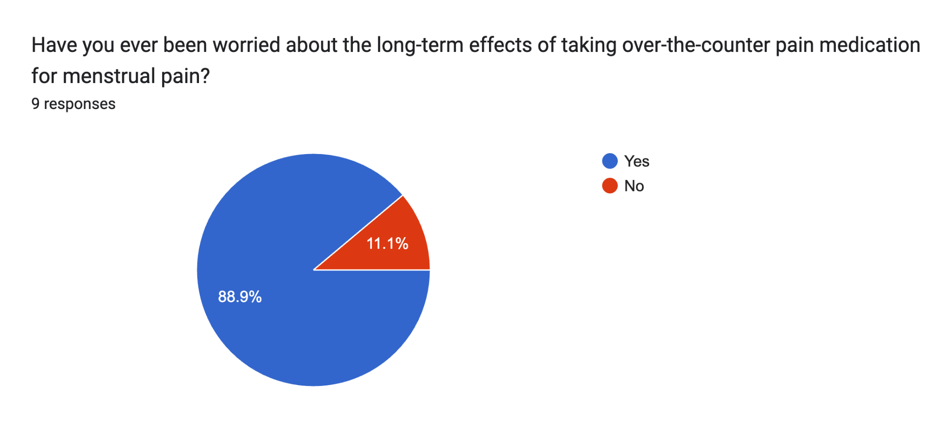
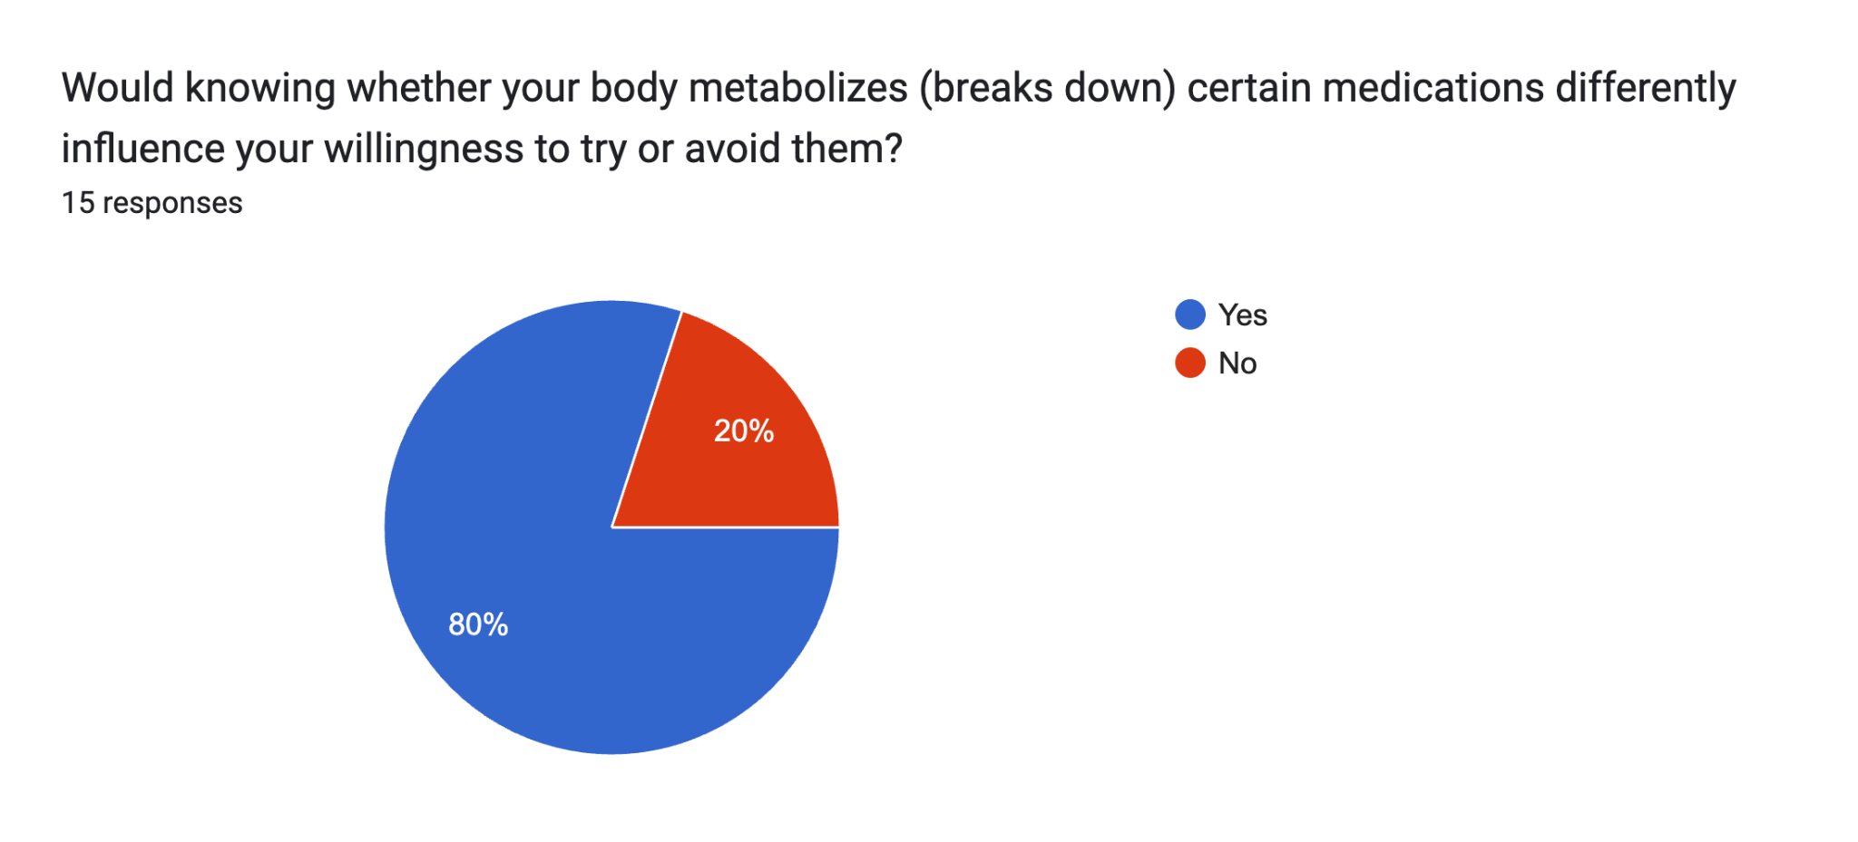
Would people spend money on our product?
Closing a gap in the market
Preventing NSAID overuse

Slide 11
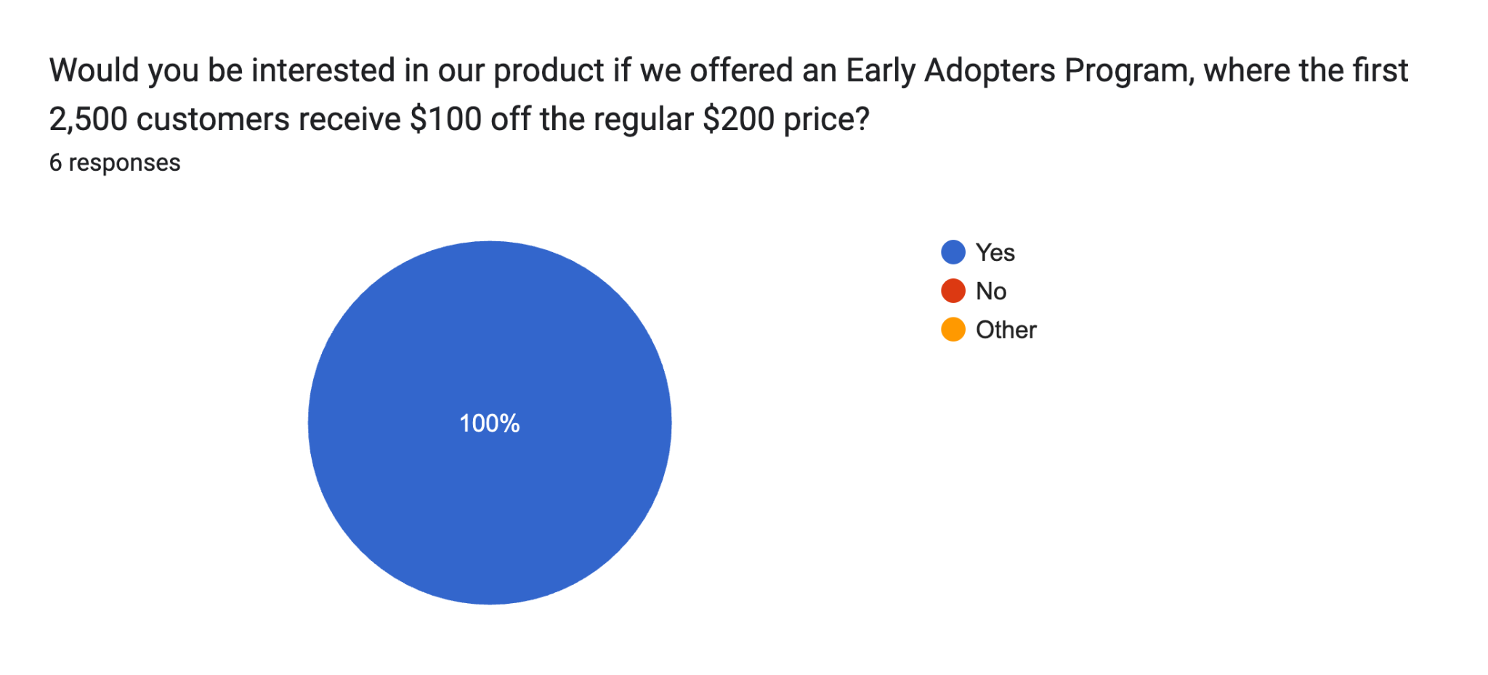
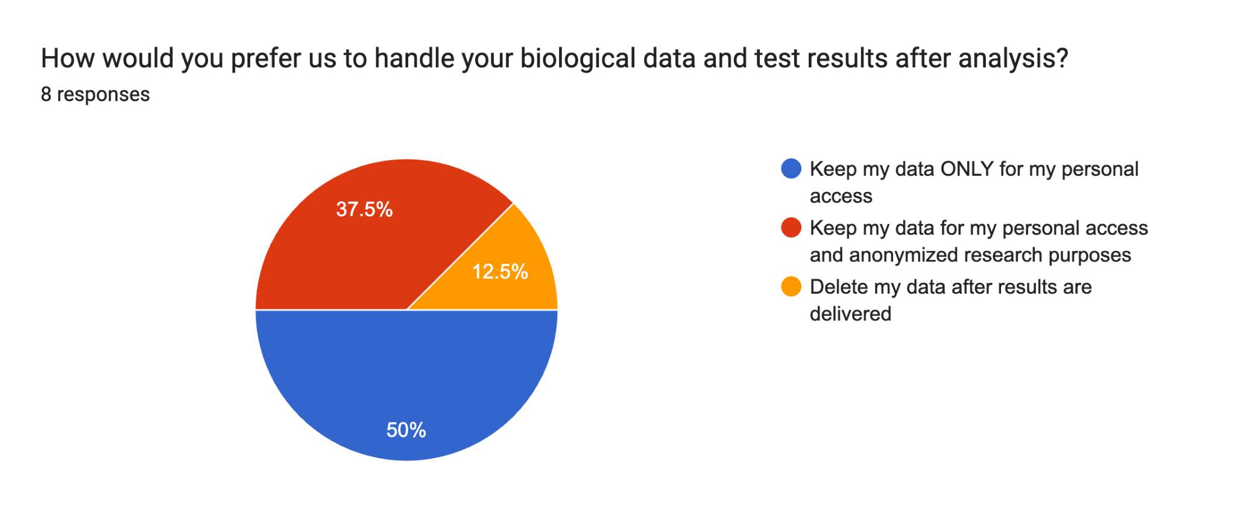
Would people spend money on our product?
Affordability
Data Privacy

Slide 12



Customer Discovery Takeaways
Affordability/cost is one of the top priorities
Product fills unique gap in market
TOP AREAS
People are concerned about possible health implications of repeated, prolonged NSAID use for menstrual pain
Data privacy is a top priority
Confidential
Notes:
Maybe we can keep slide 10 as is, and maybe throw in another graph from a survey ? asking abt data privacy. Then on this slide we can have the takeaways using this same layout (since the crowd was nutting over it). Then thats it for discovery

Slide 13
What were the estimates?
TAM
TAM:
All Menstruating Individuals ~$570.4 Billion
SAM
Region Specific, a.k.a USA ~$21.39 Billion
SOM
Assuming we can service 375k women per year (0.25%): ~$75m per year.
SAM
SOM

Slide 14
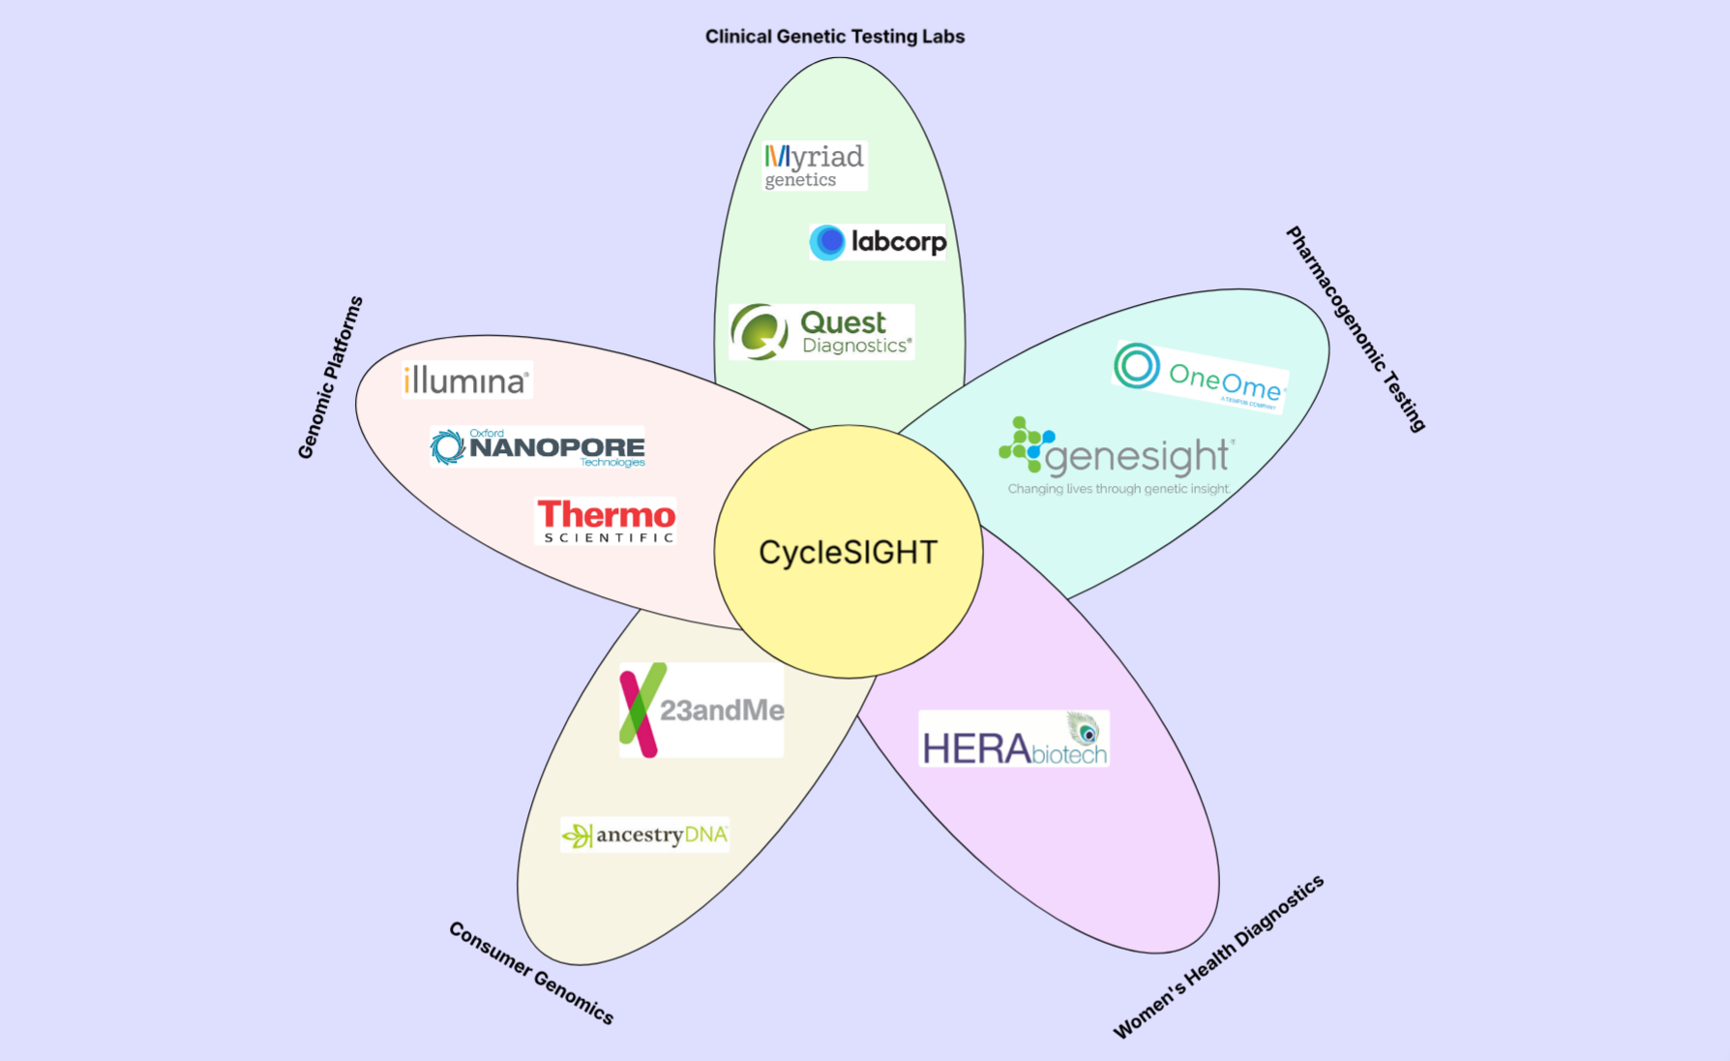

Slide 15
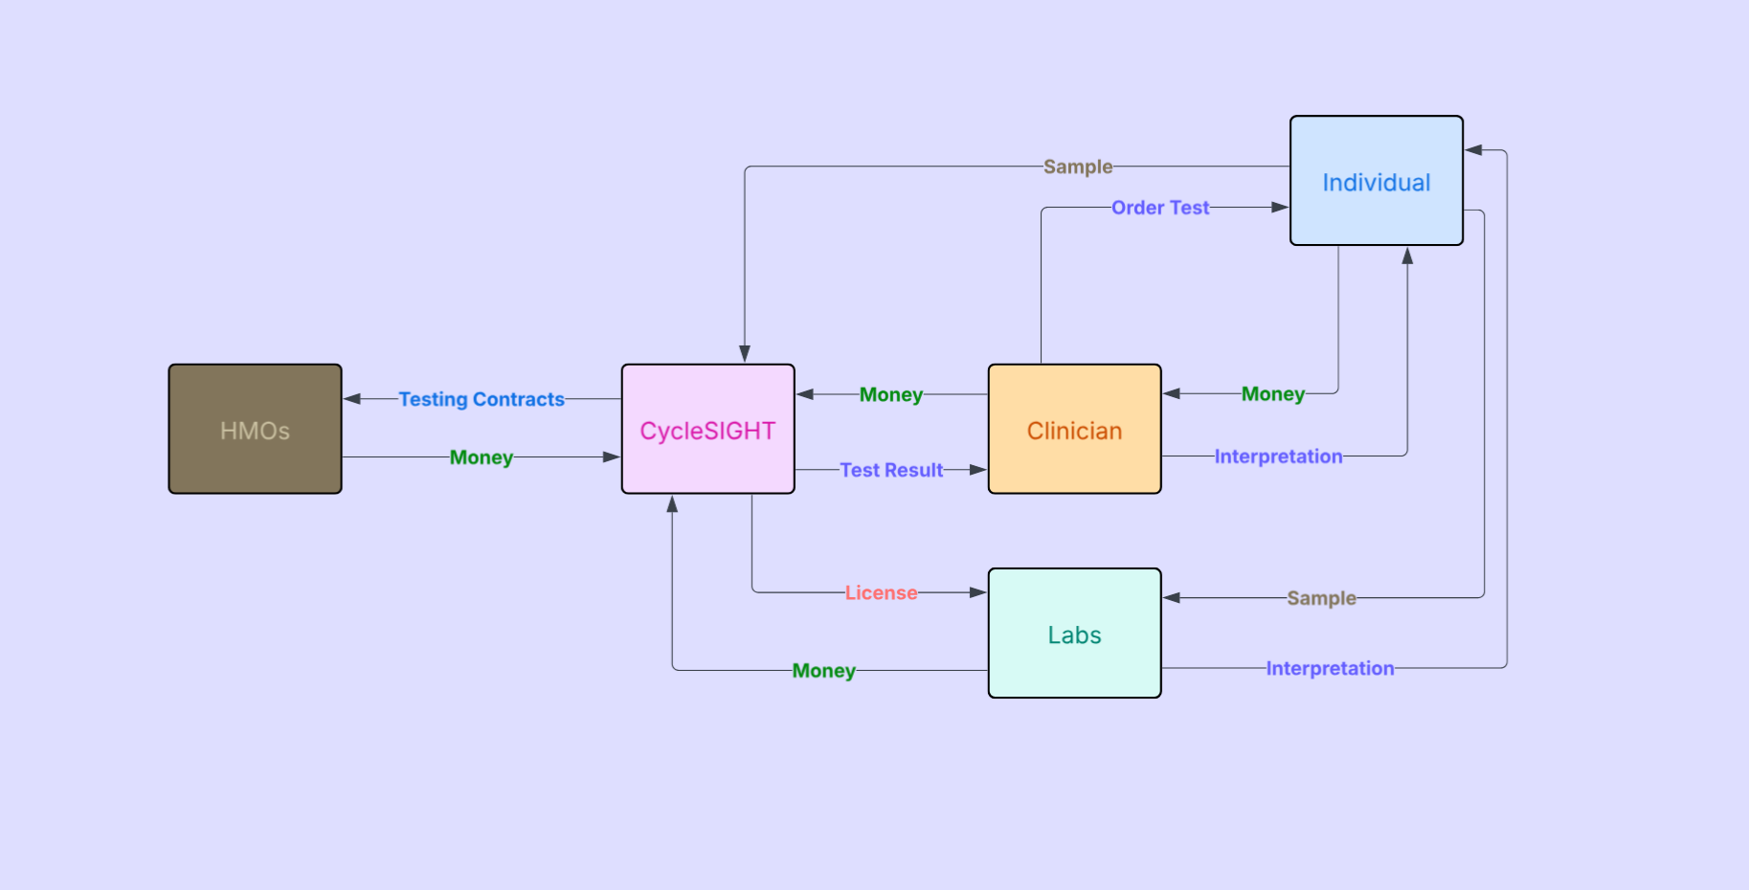

Slide 16
Timeline
January
February
March
April
May
June
July
Formalize Company Structure
In this stage, we will go through hiring processes as well as begin outreach attempts to get our company known and exposed to some clinicians and to the public
Finalization Steps
In this stage, we will finalize the workflow, rigorously hire new employees, and being pursuing a CLIA certification.
Refinement
In this stage, we will go through more outreach and launch an initial clinical pilot program in attempts to get our company known and exposed to some clinicians and to the public
WE’RE HERE
First 3 Months
The Next 4-8 Months
Next 6-12 Months
R&D Development
In this stage, we will go through the process of setting up our panel in the process, ensure that said process works and is reliably repeatable
1 Year from now
2 Years from now
Increase Scale
In this stage, we will have established everything we need to increase scale, look to establish new lab locations and even license out the process

Slide 17
Intellectual Property & Patent Acquisition
To secure our intellectual property, CycleSIGHT will file preliminary patent applications within the next four months for our six-SNP panel qPCR TaqMan laboratory-developed test.
Confidential

Slide 18
Budget: $10 Million
Research & Development and Assay Validation | $2.0 Million
Staffing and Personnel | $3.0 Million
Regulatory & CLIA Certification | $1.2 Million
Infrastructure & Lab Operations | $1.8 Million
Marketing, Outreach, and Clinical Partnerships | $1.0 Million
Operational & Administrative Costs | $1.0 Million
Confidential

Slide 19
Thank you!
CycleSIGHT
Because pain isn’t one-size-fits-all.

